Slide 1
Conway’s Game of Life
Cellular Automata

Slide 2
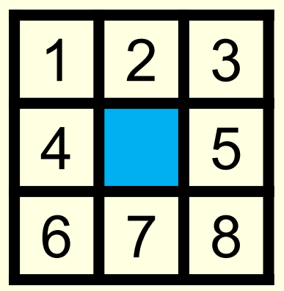
Rules
Zero player game on a 2 dimensional grid
Game moves by steps in time, and for each step, each cell updates according to the following:
If alive:
If fewer than two live neighbors, die
If more than three live neighbors, die
If two or three neighbors, stay alive
If dead:
If exactly three live neighbors, become alive

Slide 3
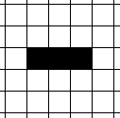
Example – Initial State
Notes:
If this is the initial state, what will the next turn of the game look like?

Slide 4
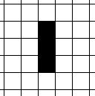
Example – Next Turn

Slide 5
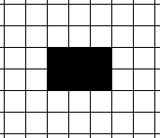
Another Example – Initial State

Slide 6
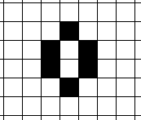
Another Example – Next Turn

Slide 7
Implementing Game of Life in Processing
We can use a 2 dimensional array of integers to represent the state of a Game of Life. The basic idea will be:
create a 2d array
randomly set the values of each element in the array to be either a 0 (dead) or a 1 (alive)
in the draw loop, set the fill based on whether the element is dead or alive, then draw a rectangle in the appropriate location
update the state of the game (take a turn) each time a key is pressed
create a new array when performing the update, then assign it to the old array when the turn is all done (avoids changing values before they should be changed)
to keep things simple when updating, simply ignore the edge cells (so we don't go out of bounds)
it can be handy to use a nested loop to determine the number of neighbors present
Notes:
Fun things to add to it: - space key advances one "turn" - r key randomized the board again - c key clears the board - mouse click toggles the state of whatever cell the mouse is on top of - t key toggles whether the game happens on its own or not... (use the Timer class) - might want to add functionality to change the speed at which the game automatically takes turns while in timer mode

